Slide 1
Hand Tracking Glove
Presented by Daniel Hamilton (EE)
Consulting Engineer - Shantanu Gulgule (EE)

Slide 2
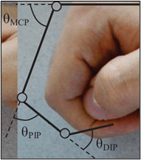
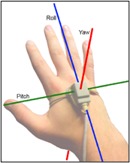
Introduction
The glove aims to capture bends in MCP and PIP finger joints and orientation of the hand.
Wirelessly transfers raw sensor data to Bluetooth devices.
Practical applications include sign language interpretation, expressive controllers for musical performances, and gaming.
Figure 1: MCP and PIP finger joints (left) and 3 axes of hand orientation (right).

Slide 3
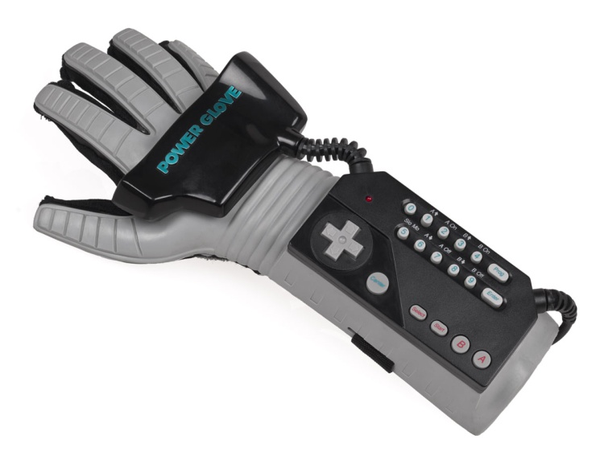
What’s out there?
This project was inspired by the Nintendo Power Glove, which was released in 1989.
Finger bend sensors allowed for 4 positions per finger on 4 fingers.
Triangulation of 2 ultrasonic speakers on the glove to capture yaw and roll (not pitch).
Notoriously difficult to use - hopefully not true for my glove!
Figure 2: The Nintendo Power Glove.

Slide 4
Description - Hardware
Build “stretch” sensors out of conductive fabrics that change resistance as they stretch. Will be placed in voltage divider circuits on each MCP and PIP joint to capture voltage readings.
Analog Multiplexers allow all 10 sensor voltages to be read using 2 ADC lines and a few mux select GPIO lines.
Accelerometer, gyroscope, and magnetometer sensors to calculate attitude and heading.
Serial to Bluetooth module for transmitting data wirelessly.
Li-ion rechargeable battery and voltage regulator as device power source.
Constant Current, Constant Voltage (CCCV) battery charger circuit.
Speaker to play a short tune when glove is plugged into charger or fully charged.
555 timer and class AB amplifier to generate 4 notes in the tune.
LCD to display battery charge percentage and Bluetooth connection status.

Slide 5
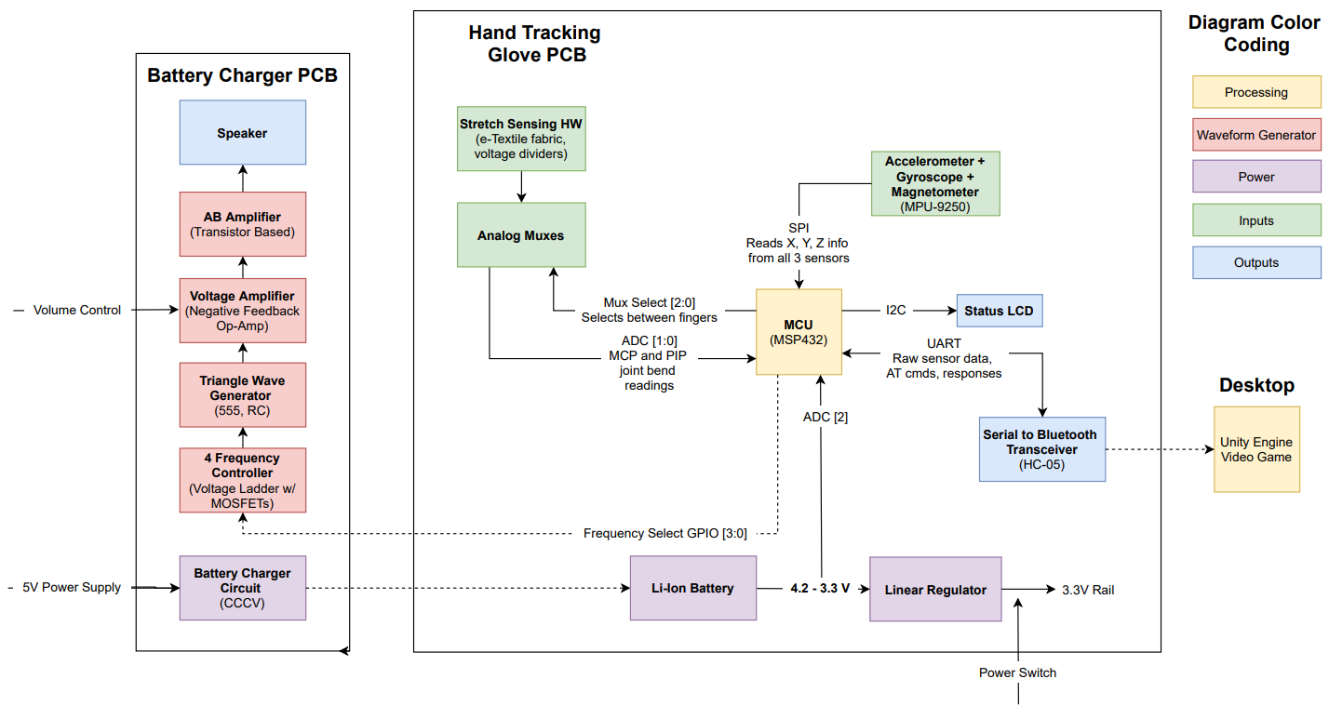
Hardware Diagram
Figure 3: High-level hardware diagram.

Slide 6
Description - Software
Glove - MSP432
Collect all sensor data and transfer the data to the desktop application with minimum latency - I2C, UART, and ADC.
Ability to recognize Bluetooth connection and disconnection.
Estimate remaining battery charge based on the battery’s discharge voltage diagram – ADC.
Control 555 timer to play specific notes in a tune – GPIO, timers, and interrupts.
Desktop Application
Connect, disconnect, and decode messages transferred over Bluetooth.
Calculate hand orientation using the gyroscope while compensating for gyro drift with accelerometer and magnetometer.
Make a video game in Unity/C# that can be controlled using the processed glove inputs.

Slide 7
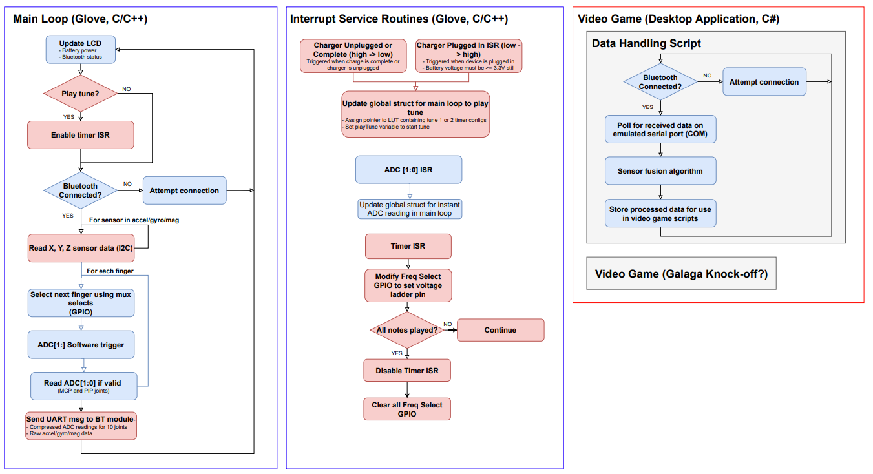
Software Flowchart
Figure 4: High-level software flowchart.
Notes:
Glove’s primary goals are to collect/transfer raw data to the desktop with minimum latency.
Desktop application performs most data processing.
Processed data controls the video game demo.

Slide 8
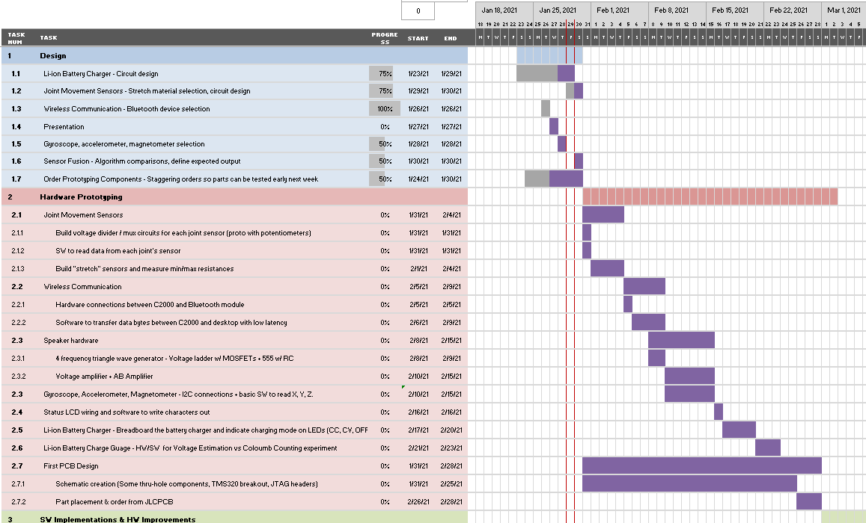
Gantt Chart
First few weeks of Gantt chart shown to the right.
~3 weeks of research & design
~4 weeks of HW Prototyping (PCB 1 design at end)
~4 weeks of SW Implementation & HW Improvements (PCB 2 design at end)
~3 weeks of polish and stretch goals (if time allows)
Figure 5: Gantt chart for project timeline.

Slide 9
Questions

